Slide 1
Use of Digital Technology to calculate water footprints for different daily use items.
CSE7101- Capstone Project
Review-2
Batch Number: CIT_26
Under the Supervision of,
Ms. Chandana C
Assistant Professor
School of Information Science
Presidency University
Roll Number | Student Name
20221CIT0049 | C M SHALINI
20221CIT0043 | AMRUTHA M
20221CIT0151 | VASHINI R
Name of the Program: B. Tech(Computer Science & Engineering (Internet of Things) )
Name of the HoD: Dr. Anandaraj S.P
Name of the Program Project Coordinator: Dr. Sharmasth Vali
Name of the School Project Coordinators: Dr. Sampath A K , Dr. Geetha A

Slide 2
Problem Statement Number: PSCS_4
Organization: Ministry of Jal Shakti
Category (Hardware / Software / Both) : Software
Problem Description:
Freshwater scarcity is a major global challenge.
Most people are unaware of daily water consumption in products and activities.
Existing studies on water usage are not user-friendly for individuals.
The project will create a digital platform to calculate and visualize water footprints.
Goal: Help users adopt sustainable practices and reduce unnecessary water consumption.

Slide 3
Content
Abstract
Objectives
Literature Survey
Existing Methods and Drawbacks
Proposed Method & Feasibility Study
Architecture Diagram
Modules
Hardware & Software Details
Timeline of the Project (Gantt Chart)
References (IEEE Paper format)

Slide 4
Abstract
Objectives :
Awareness Creation
User-Friendly Digital Solution
Data Accessibility
Behavioral Change & Action
Policy & Research Support
Preventive Impact

Slide 5
Literature Survey
Dourte et al. (2014) — WaterFootprint on AgroClimate: A dynamic, web-based tool. Describes architecture, performance and UX considerations for a web calculator used by growers.
Feng et al. (2021) — A quantitative review of water footprint accounting and applications. Survey of methods and calculation choices; helpful to pick consistent formulas/parameters.
Fu et al. (2022) — Measurement and driving factors of grey water footprint… (Yangtze Basin). LMDI decomposition + grey-WF method—handy for regional calculator modules.
Okutan et al. (2021) — Identification of water use behavior and calculation of a university’s water footprint. Questionnaire-based calculator design and per-capita outputs (household/institution angle).
D. Jefferies, I. Muñoz, J. Hodges, V. J. King, M. Aldaya, A. E. Ercin, L. Milà i Canals, and A. Y. Hoekstra, "Water footprint and life cycle assessment as approaches to assess potential impacts of products on water consumption: Key learning points from pilot studies on tea and margarine," Journal of Cleaner Production, vol. 33, pp. 155–166, Sept. 2012. doi: 10.1016/j.jclepro.2012.04.015

Slide 6
Literature Survey (contd…)
R. M. Willis, R. A. Stewart, K. Panuwatwanich, P. R. Williams, and A. L. Hollingsworth, “End use water consumption in households: Impact of socio-demographic factors and efficient devices,” Journal of Cleaner Production, vol. 60, pp. 107–115, Jan. 2011. doi: 10.1016/j.jclepro.2011.08.006
K. Islam and S. Murakami, “Accounting for water footprint of an open-pit copper mine,” Sustainability, vol. 10, no. 5, p. 1548, May 2018. doi: 10.3390/su10051548.
Y. Gu, S. Chen, and M. Li, “Uncovering the dynamics of consumption-based household water footprint in response to pandemic: The hysteresis effect of disruption,” Earth’s Future, vol. 11, no. 5, e2022EF003088, Apr. 2023. doi: 10.1029/2022EF003088.
Rezvaneh Barzegar Nemati, A. H. Mahvi, M. H. Dehghani, S. H. Borji, and M. Hadi, “A feasibility study to estimate household water footprint in Iran: Adaptation and application of a localized questionnaire,” Cleaner Water, vol. 2, p. 100043, 2024. doi: 10.1016/j.clwat.2024.100043
Meghnadh Bijnapally , Shubranshu ranjan dash , Vikyath reddy Sama “Water Footprint Calculator: Tracking Daily Water Usage with Digital Tech ", JNRID - JOURNAL OF NOVEL RESEARCH AND INNOVATIVE DEVELOPMENT (www.JNRID.org), ISSN:2984-8687, Vol.2, Issue 11, page no.a109-a121, November-2024,

Slide 7
Existing Methods & Drawbacks
Current Approaches | Limitations
Water Footprint Assessment (Blue, Green, Grey) – Life Cycle Analysis used to estimate usage at different product stages. | Lack of standardization across methods; temporal variations (seasonal/annual) often ignored.
Survey & Questionnaire-Based Tools – Collect appliance/household usage data, compare with averages. | Relies on average values and self-reported data → may be inaccurate, lacks real-time/local specificity.
Digital Platforms (Web-Based) – Use HTML/JS front-end, Java/Python back-end, MySQL databases; provide charts/maps. | Mostly web-only, limited mobile integration and offline access; restricted personalization.
Data Visualization & Awareness Features – Graphs, comparisons, water-saving tips. | Good for awareness, but lacks predictive analytics and AI-driven personalization.
Pilot Implementations – Dashboards showing user vs. average usage; tailored suggestions. | No CI/CD or automation, making systems harder to maintain.

Slide 8
Proposed Method & Feasibility Study
Interactive Frontend (HTML, JS + Streamlit): Real-time dashboards & visualizations; lightweight & quick to develop.
FastAPI Backend: High-performance microservices; easy AI/ML model integration for real-time water footprint calculation.
PostgreSQL + Redis: Reliable structured storage with caching for fast, real-time lookups.
AI/ML Models (Linear Regression → XGBoost): Multi-model approach ensures accurate predictions & personalized recommendations.
CI/CD with GitHub Actions: Automated testing & deployment; increases reliability and maintainability.
Open-Source & Scalable Stack: All chosen technologies are free, widely used, and industry-proven → practical for both prototype & real-world deployment.

Slide 9
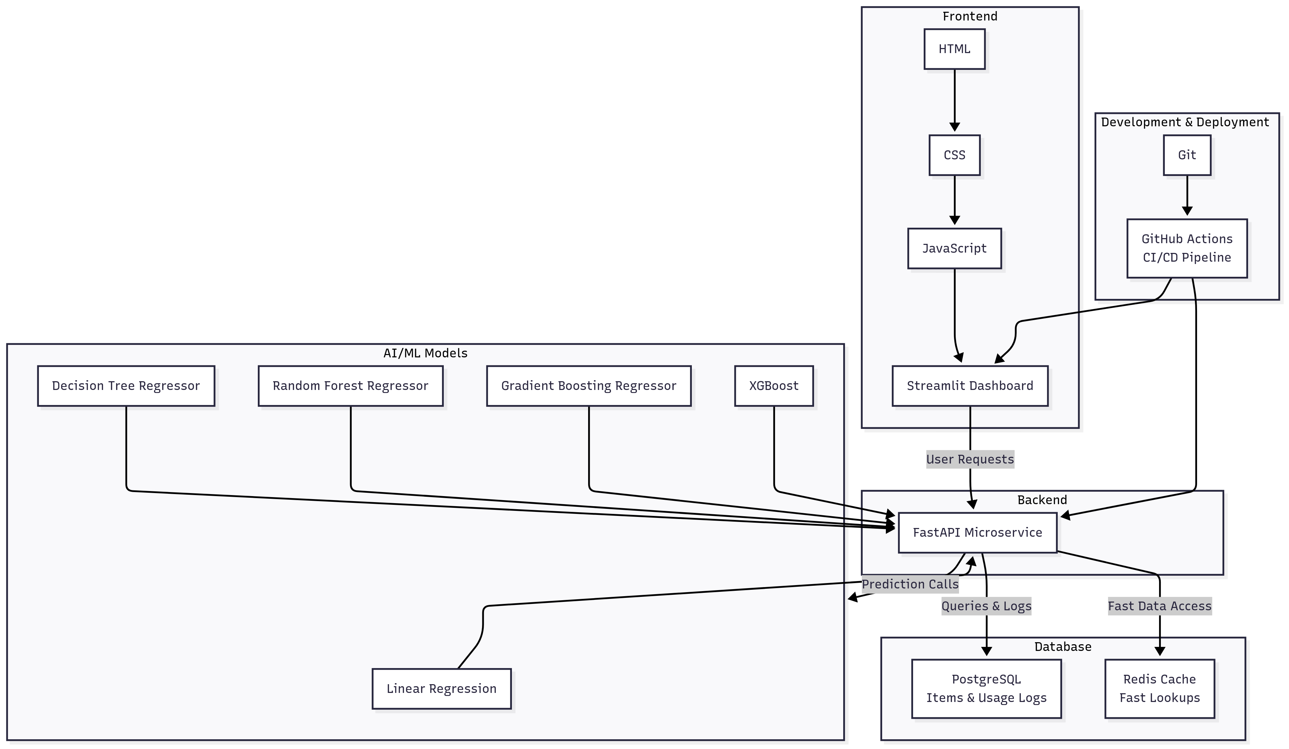
Architecture Diagram (Main Diagram)

Slide 10
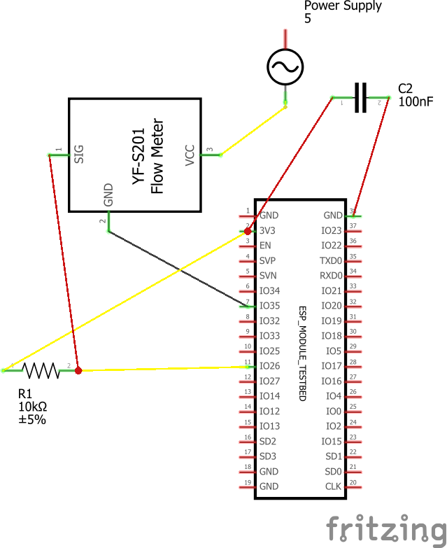
Architecture Diagram (IoT Device Circuit Diagram)

Slide 11
Modules
Frontend (HTML, CSS, JS, Streamlit) → User interface, interactivity, dashboards & visualizations.
Backend (FastAPI – Python) → REST APIs, water footprint calculation logic, request handling.
Database (PostgreSQL + Redis) → PostgreSQL for storing items, users, logs; Redis for fast caching & lookups.
AI/ML Layer → Linear Regression (baseline, interpretable), Decision Tree (non-linear patterns), Random Forest (robust ensemble), Gradient Boosting (strong structured data performance) and XGBoost (high efficiency & accuracy). It provides predictions, trends & personalized recommendations.
Development & Deployment (Git + GitHub Actions) → Version control, CI/CD automation, reliable deployment.

Slide 12
Hardware & Software Details
Software Requirements:
Frontend:
HTML, CSS, JavaScript – for structure, styling, and interactivity
Streamlit – framework for creating interactive dashboards and visualizations
Backend:
FastAPI (Python) – microservice framework for building high-performance REST APIs and handling water footprint calculation logic
Database:
PostgreSQL – relational database for storing items, user accounts, and consumption logs
Redis – in-memory caching layer to improve query performance and speed up repeated lookups

Slide 13
Hardware & Software Details (contd...)
AI/ML Layer: Used for prediction, trend analysis, and providing personalized recommendations:
Linear Regression – baseline model for interpretability
Decision Tree Regressor – handles non-linear usage patterns
Random Forest Regressor – ensemble method to improve robustness
Gradient Boosting Regressor – strong predictive performance on structured data
XGBoost – optimized boosting algorithm with high accuracy and efficiency
Development & Deployment Tools:
Git & GitHub Actions – version control and CI/CD automation

Slide 14
Hardware & Software Details (contd...)
Hardware Requirements:
Minimum (Development Environment)
Processor: Intel i3 (or equivalent)
RAM: 4 GB
Storage: 100 GB HDD
Recommended (Development + Deployment)
Processor: Intel i5
RAM: 8 GB or above
Storage: 250 GB SSD
Internet: Stable connection for cloud deployment
Optional (Cloud/Server Deployment)
2–4 vCPUs

Slide 15
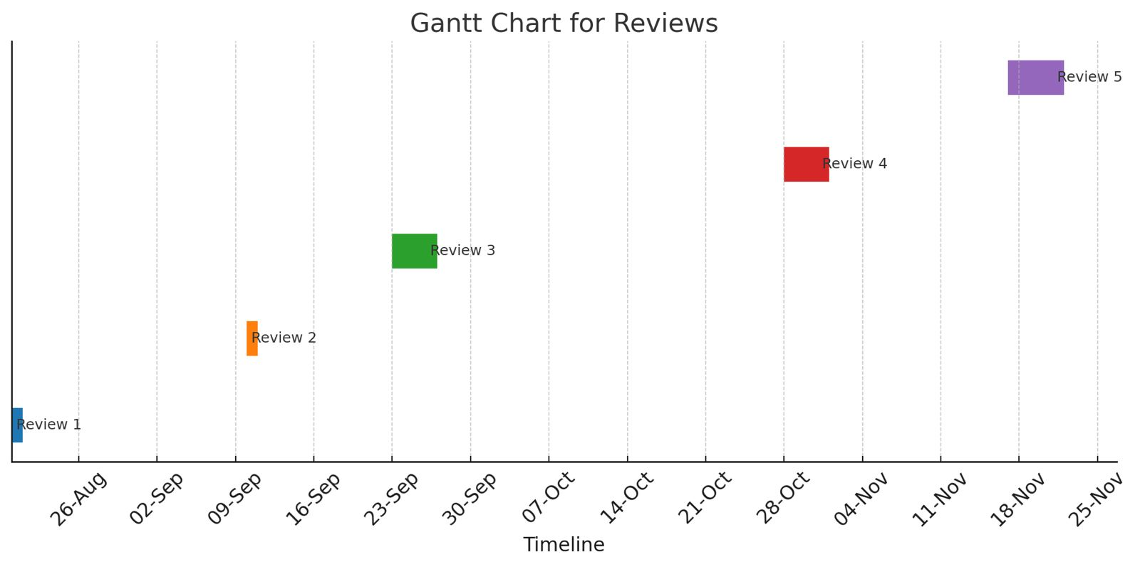
Timeline of the Project (Gantt Chart)
Gantt Chart for Reviews :

Slide 16
References (IEEE Paper format)
[1] Meghnadh Bijnapally , Shubranshu ranjan dash , Vikyath reddy Sama “Water Footprint Calculator: Tracking Daily Water Usage with Digital Tech ", JNRID - JOURNAL OF NOVEL RESEARCH AND INNOVATIVE DEVELOPMENT (www.JNRID.org), ISSN:2984-8687, Vol.2, Issue 11, page no.a109-a121, November-2024,
[2] Hoekstra, A.Y., et al. "The Water Footprint of Humanity." PNAS, 2012. [2] Mekonnen, M.M.,Hoekstra, A.Y. "A Global Assessment of the Water Footprint of Farm Animal Products."Ecosystems, 2012. [3] FAO, UNESCO reports on water use and sustainability. [4] Recent work on AI in sustainability (Nature Sustainability, IEEE Access)

Slide 17


